Slide 1
A day in the life of Nursery
It’s not just playing!

Slide 2
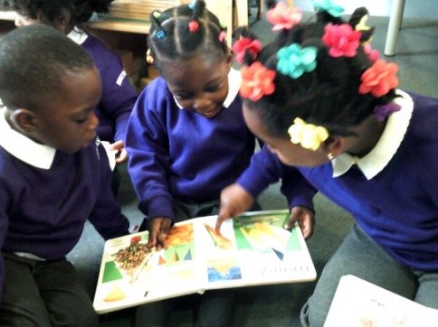
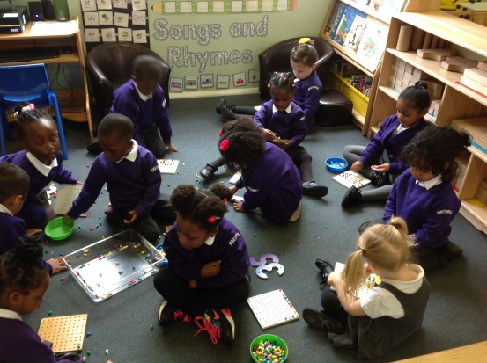
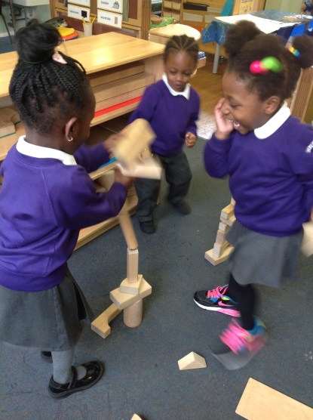
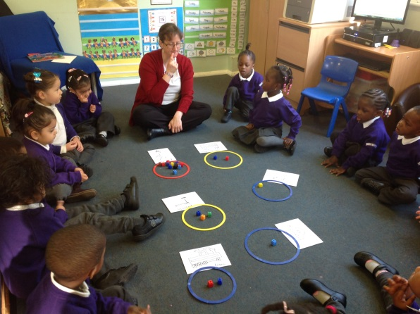
It’s always a busy day!
Carpet activities
Carpet learning time
Snack time
Inside outside playtime
Tidy up
Phonics
Story/milk and singing
Home time

Slide 3
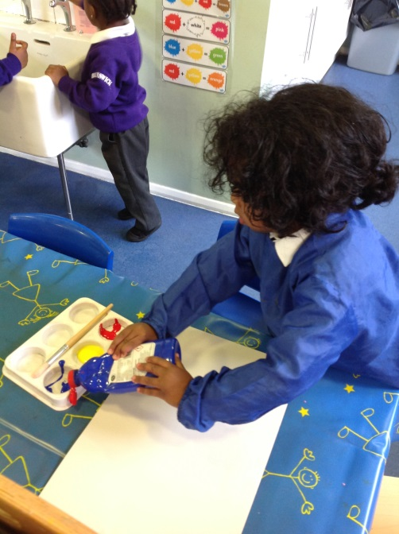
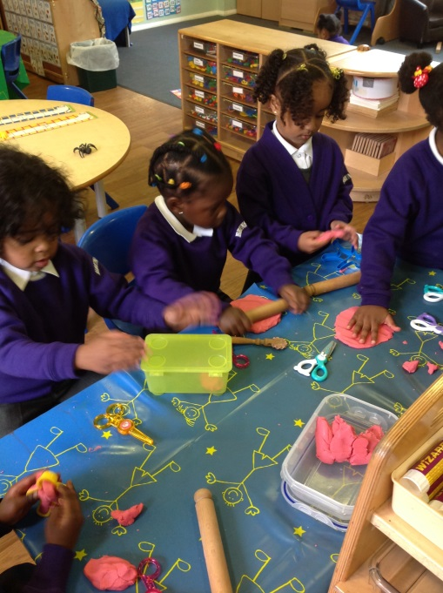
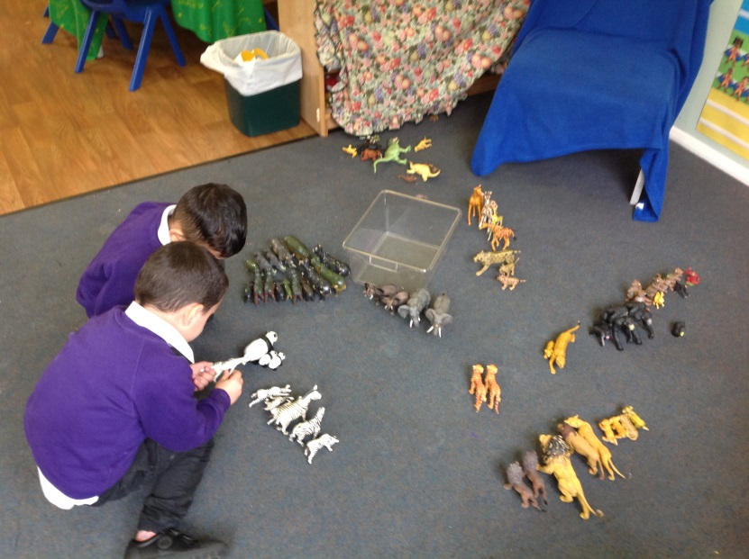
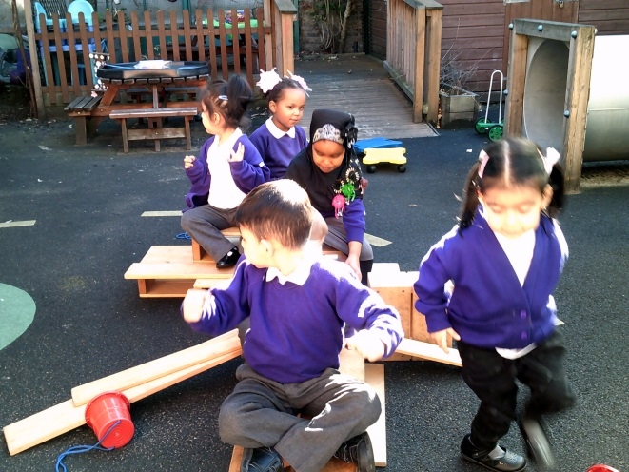
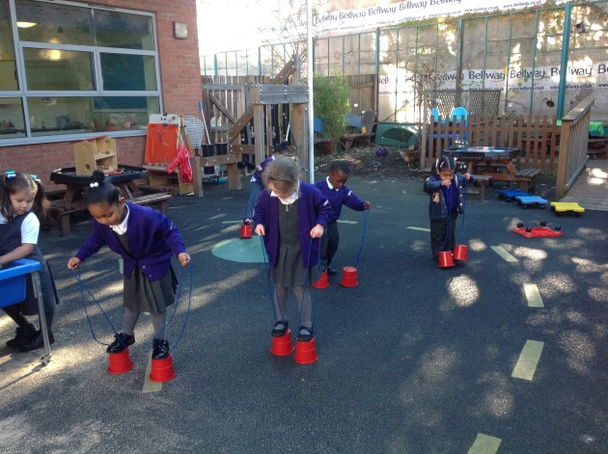
Do children really learn through play?
YES!!

Slide 4
Through play they learn to…
be self confident
take turns and share with others
express themselves in different ways
talk about and solve small problems themselves
learn the values of kindness, respect and caring for others
be independent
develop listening and attention skills
build relationships and friendships
enjoy education!

Slide 5
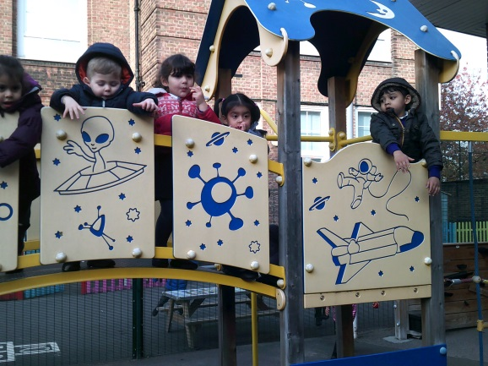
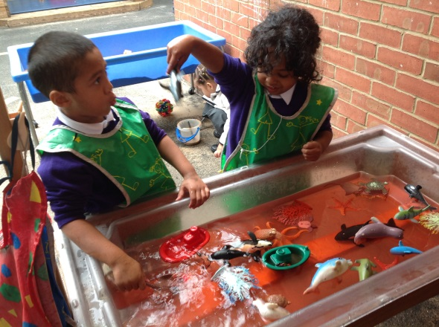
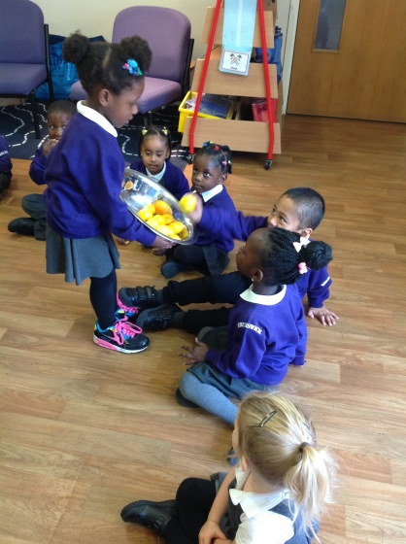
The main focus in Nursery is…
Communication and Language Development
Physical Development
Personal, Social and Emotional Development
Through success in these three prime areas, learning in all of the other areas is much more successful.

Slide 6
Phonics in Nursery!
Listening for sounds
Playing sounds
Learning rhythms and rhymes
Exploring and experimenting with body and voice sounds
Learning to put sounds together
Sounds objects and words begin with
Learning to say the sounds correctly
Talking about sounds e.g. high, low, fast, slow, loud, quiet etc.
Learning all of these skills allow the children to be successful in reading and writing as they move through their education.

Slide 7
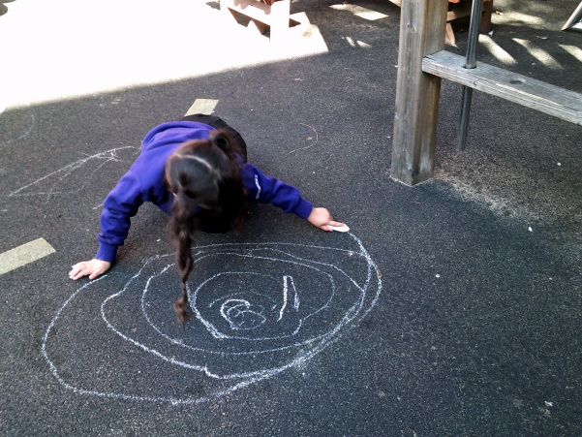
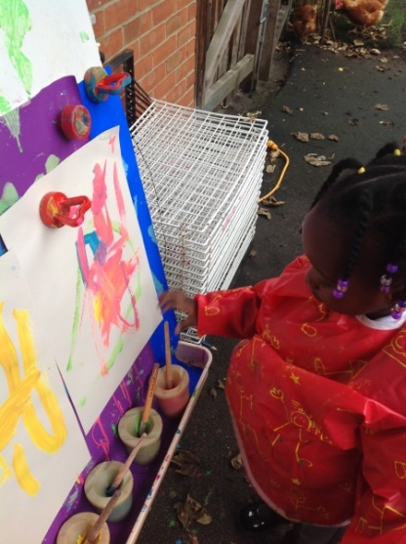
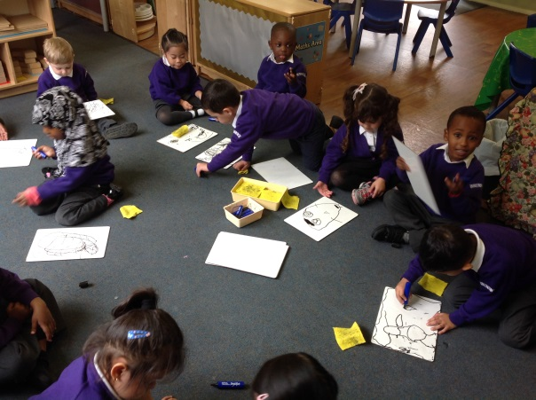
Don’t underestimate the importance of mark making and drawing!
Children learn to draw before they write
Early mark making is the step before learning to write
Drawing allows children to develop essential pencil control and clarity of lines and shapes
Development in drawing is essential for success in writing

Slide 8
Everything that we do helps them to be ready for the next step…
Reception!
Apply online now for your place from Reception 2019
Go to: www.southwark.co.uk and search primary admissions

